Slide 1
Section 3.3
Properties of Functions
Copyright © 2012 Pearson Education, Inc. Publishing as Prentice Hall.

Slide 2


Copyright © 2012 Pearson Education, Inc. Publishing as Prentice Hall.

Slide 3

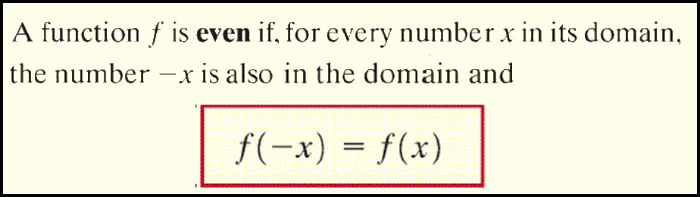
For an even function, for every point (x, y) on the graph, the point (-x, y) is also on the graph.
Copyright © 2012 Pearson Education, Inc. Publishing as Prentice Hall.

Slide 4
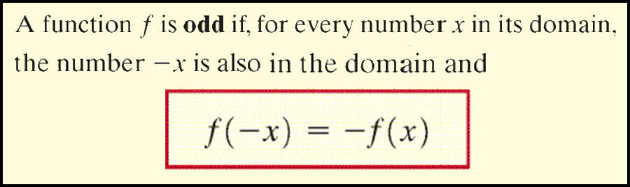
So for an odd function, for every point (x, y) on the graph, the point (-x, -y) is also on the graph.
Copyright © 2012 Pearson Education, Inc. Publishing as Prentice Hall.

Slide 5
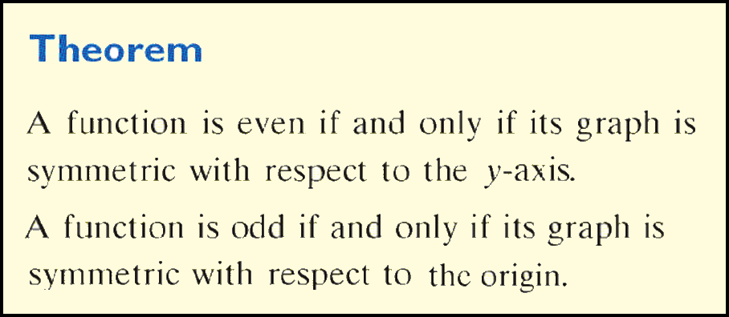
Copyright © 2012 Pearson Education, Inc. Publishing as Prentice Hall.

Slide 6

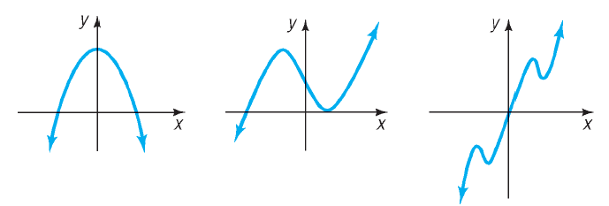
Determine whether each graph given is an even function, an odd function, or a function that is neither even nor odd.
Even function because it is symmetric with respect to the y-axis
Neither even nor odd because no symmetry with respect to the y-axis or the origin
Odd function because it is symmetric with respect to the origin
Copyright © 2012 Pearson Education, Inc. Publishing as Prentice Hall.

Slide 7
Copyright © 2012 Pearson Education, Inc. Publishing as Prentice Hall.

Slide 8
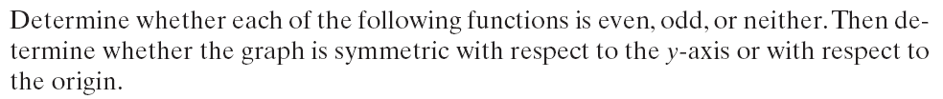
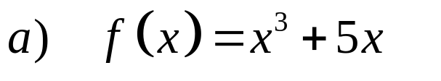
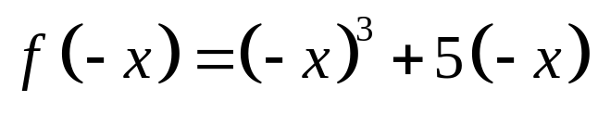

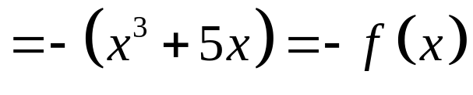
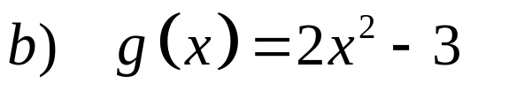
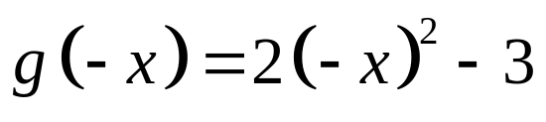
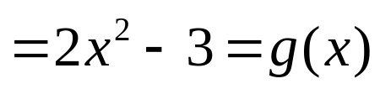
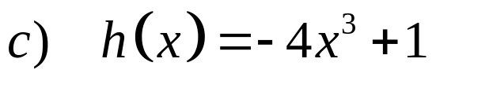
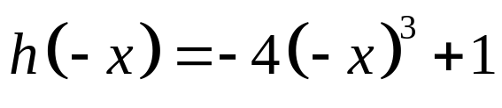

Odd function symmetric with respect to the origin
Even function symmetric with respect to the y-axis
Since the resulting function does not equal h(x) nor –h(x) this function is neither even nor odd and is not symmetric with respect to the y-axis or the origin.
Copyright © 2012 Pearson Education, Inc. Publishing as Prentice Hall.

Slide 9
CONSTANT
INCREASING
DECREASING
Copyright © 2012 Pearson Education, Inc. Publishing as Prentice Hall.

Slide 10
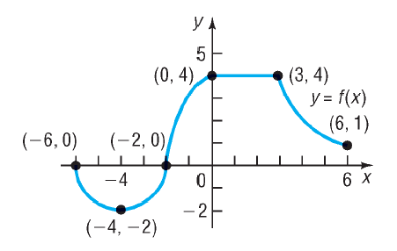


Where is the function increasing?
Copyright © 2012 Pearson Education, Inc. Publishing as Prentice Hall.

Slide 11




Where is the function decreasing?
Copyright © 2012 Pearson Education, Inc. Publishing as Prentice Hall.

Slide 12


Where is the function constant?
Copyright © 2012 Pearson Education, Inc. Publishing as Prentice Hall.

Slide 13

Copyright © 2012 Pearson Education, Inc. Publishing as Prentice Hall.

Slide 14
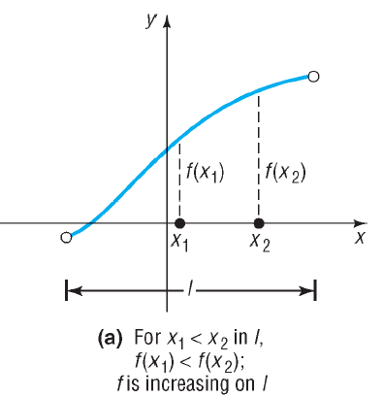
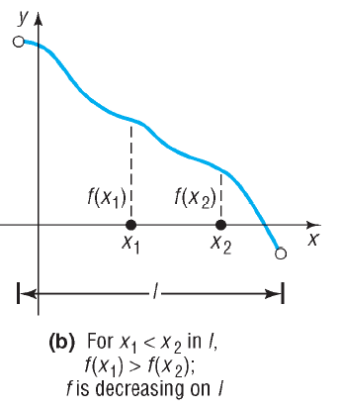
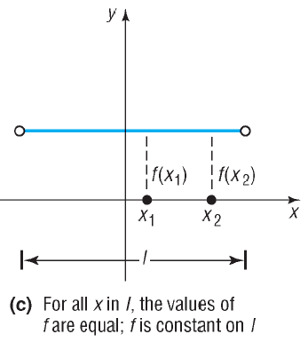
Copyright © 2012 Pearson Education, Inc. Publishing as Prentice Hall.

Slide 15


Copyright © 2012 Pearson Education, Inc. Publishing as Prentice Hall.

Slide 16
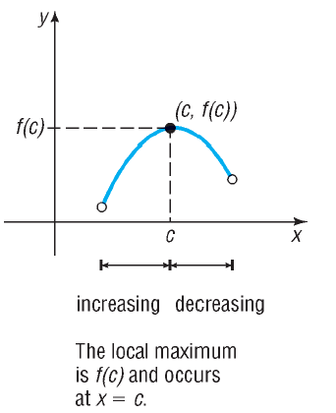
Copyright © 2012 Pearson Education, Inc. Publishing as Prentice Hall.

Slide 17
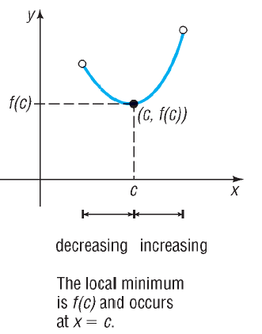
Copyright © 2012 Pearson Education, Inc. Publishing as Prentice Hall.

Slide 18

Copyright © 2012 Pearson Education, Inc. Publishing as Prentice Hall.

Slide 19

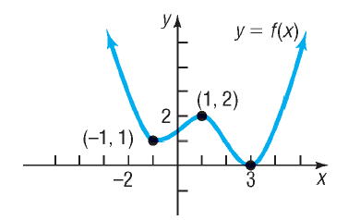
There is a local maximum when x = 1.
The local maximum value is 2.
Copyright © 2012 Pearson Education, Inc. Publishing as Prentice Hall.

Slide 20
There is a local minimum when x = –1 and x = 3.
The local minima values are 1 and 0.
Copyright © 2012 Pearson Education, Inc. Publishing as Prentice Hall.

Slide 21
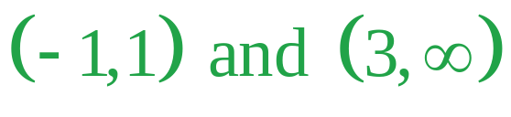
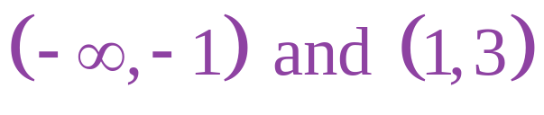
(e) List the intervals on which f is increasing.
(f) List the intervals on which f is decreasing.
Copyright © 2012 Pearson Education, Inc. Publishing as Prentice Hall.

Slide 22

Copyright © 2012 Pearson Education, Inc. Publishing as Prentice Hall.

Slide 23
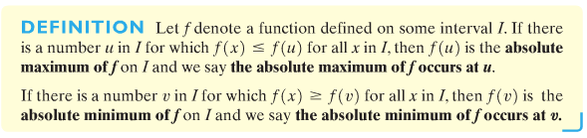
Copyright © 2012 Pearson Education, Inc. Publishing as Prentice Hall.

Slide 24
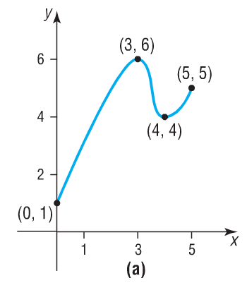
Find the absolute maximum and the absolute minimum, if they exist.
The absolute maximum of 6 occurs when x = 3.
The absolute minimum of 1 occurs when x = 0.
Copyright © 2012 Pearson Education, Inc. Publishing as Prentice Hall.

Slide 25
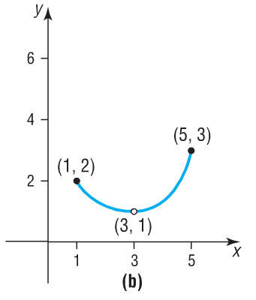
Find the absolute maximum and the absolute minimum, if they exist.
The absolute maximum of 3 occurs when x = 5.
There is no absolute minimum because of the “hole” at x = 3.
Copyright © 2012 Pearson Education, Inc. Publishing as Prentice Hall.

Slide 26
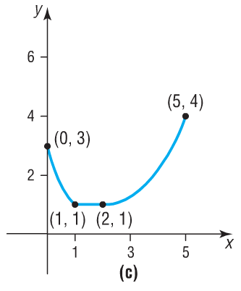
Find the absolute maximum and the absolute minimum, if they exist.
The absolute maximum of 4 occurs when x = 5.
The absolute minimum of 1 occurs on the interval [1,2].
Copyright © 2012 Pearson Education, Inc. Publishing as Prentice Hall.

Slide 27
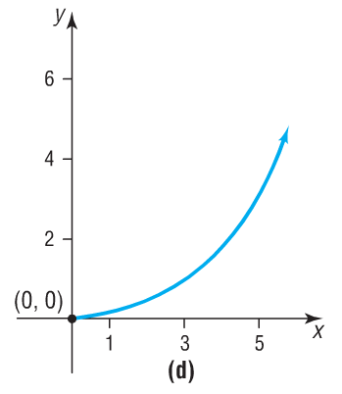
Find the absolute maximum and the absolute minimum, if they exist.
There is no absolute maximum.
The absolute minimum of 0 occurs when x = 0.
Copyright © 2012 Pearson Education, Inc. Publishing as Prentice Hall.

Slide 28
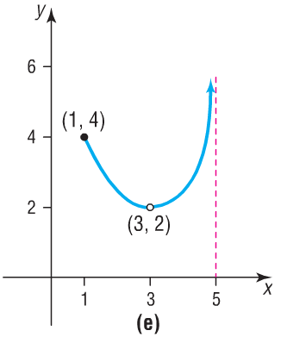
Find the absolute maximum and the absolute minimum, if they exist.
There is no absolute maximum.
There is no absolute minimum.
Copyright © 2012 Pearson Education, Inc. Publishing as Prentice Hall.

Slide 29

Copyright © 2012 Pearson Education, Inc. Publishing as Prentice Hall.

Slide 30

Copyright © 2012 Pearson Education, Inc. Publishing as Prentice Hall.

Slide 31

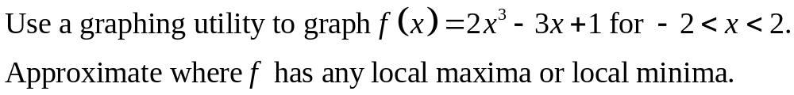



Copyright © 2012 Pearson Education, Inc. Publishing as Prentice Hall.

Slide 32
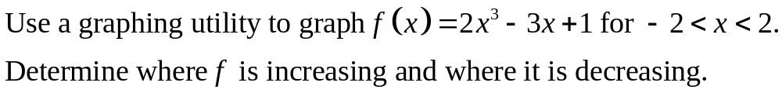
Copyright © 2012 Pearson Education, Inc. Publishing as Prentice Hall.

Slide 33
Copyright © 2012 Pearson Education, Inc. Publishing as Prentice Hall.

Slide 34

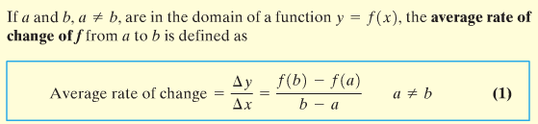
Copyright © 2012 Pearson Education, Inc. Publishing as Prentice Hall.

Slide 35

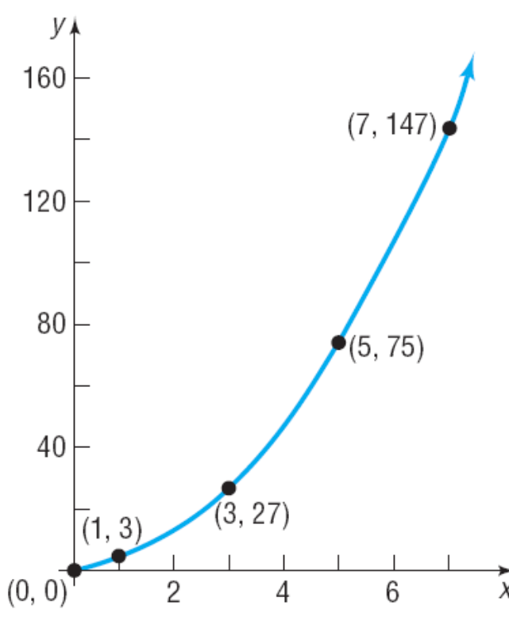
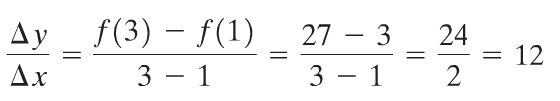
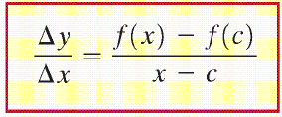
a) From 1 to 3
Copyright © 2012 Pearson Education, Inc. Publishing as Prentice Hall.

Slide 36

b) From 1 to 5
Copyright © 2012 Pearson Education, Inc. Publishing as Prentice Hall.

Slide 37

c) From 1 to 7
Copyright © 2012 Pearson Education, Inc. Publishing as Prentice Hall.

Slide 38

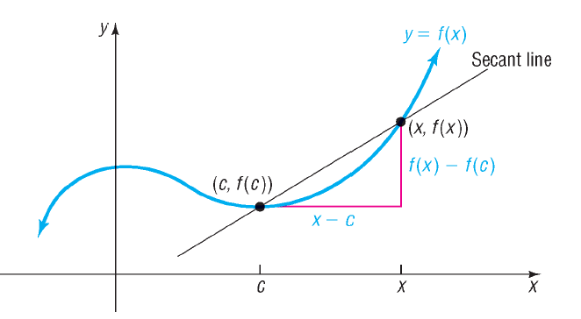
Copyright © 2012 Pearson Education, Inc. Publishing as Prentice Hall.

Slide 39


Copyright © 2012 Pearson Education, Inc. Publishing as Prentice Hall.

Slide 40
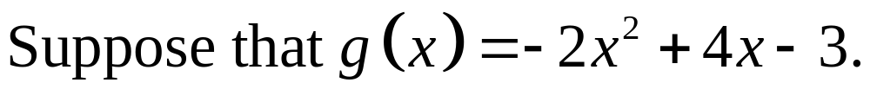
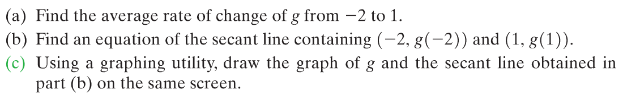
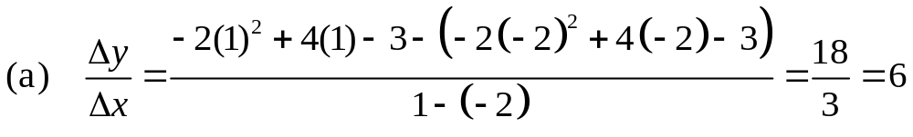





2
-4
3
-25
Copyright © 2012 Pearson Education, Inc. Publishing as Prentice Hall.

